Slide 1
MSE 609 Final Project
"Knowledge Is Not All You Need For Comfort in Use of AI in Healthcare"
MSE 609 - Group 11 – Fall 2025
Kaichen Sun, Deep Agam, Aymen Mehrez,
Zayn Dhillon, Wentao Zang, & Leila Safari
Notes:
Hello everyone, today our group is presenting a replication of a recent research paper titled “Knowledge is not all you need for comfort in use of AI in healthcare.”
This study looked at how Canadians feel about AI being used in healthcare, and how demographic factors influence both their knowledge and level of comfort.
In our project, we replicated key parts of the original study and extended the analysis using additional datasets from 2023 and 2024.

Slide 2
Project Overview & Why It Matters
Replicating Li et al. (2025):
  How demographics shape AI knowledge & comfort in healthcare
Why It Matters:
  AI adoption rising → public trust depends on transparency, inclusion & data governance
What We Replicated:
  Table 1, Appendix A1, Figures 1–4
What We Extended:
  2023 & 2024 CDHS datasets
Notes:
Speaker Notes:
This project replicates Li et al. (2025), who examined how demographics shape AI knowledge and comfort in healthcare.
This is important because AI in healthcare is expanding quickly, and trust depends on transparency, inclusive design, and strong data governance.
We replicated their main results — Table 1, Appendix A1, and the 3D figures — and extended the analysis using newer 2023 and 2024 datasets.

Slide 3
Data & Variables
Independent Variables
Age (5 groups)
Gender (3 categories)
Income (7 brackets)
Education (7 levels)
Data Source
CDHS 2021 (n = 12,052)
Extension: 2023 & 2024
Dependent Variables (Likert 1–4)
Q40 – AI knowledge
Q41 – Comfort with AI in healthcare
Q42 – Comfort with AI research (consent)
Q43 – Comfort with AI research (no consent, de-identified)
Notes:
Speakers' Note
We use the Canadian Digital Health Survey from 2021, which includes over twelve thousand responses about demographics, health, and attitudes toward AI. This dataset contains the same variables used in the original study, so it allows us to replicate their results.
Our dependent variables are four survey questions — one measuring AI knowledge and three measuring comfort with AI in different contexts.
Our independent variables are demographic: age, gender, income, and education. Because these are categorical with multiple levels, we apply ordinal logistic regression rather than linear models

Slide 4
Data Cleaning Pipeline
Missing values coded 96–99 removed
Two filtering strategies:
  Strict: Must answer all 8 variables
  Standard: Only independent variables must be valid
Resulting samples:
  n = 9,198 (strict → Table 1)
  n = 10,553 (standard → models & figures)
Notes:
A major part of our project was matching how the original researchers cleaned the data.
Responses coded between 96 and 99 had to be discarded because they represent missing or “don’t know” answers.
We used two filtering strategies: strict filtering for Table 1, and standard filtering for the models and figures.
This difference in filtering explains why some sample sizes change between analyses.

Slide 5
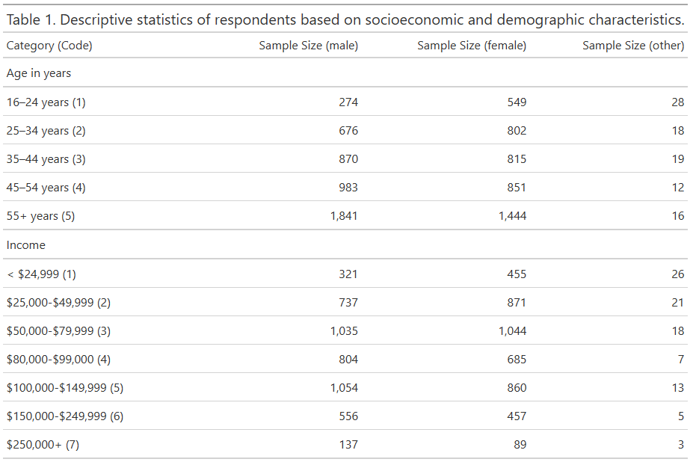
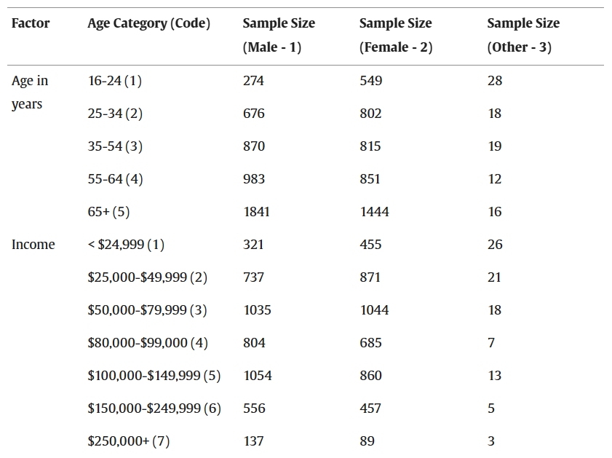
Replication of Table 1
Only difference: Age category bins due to dataset constraints
Achieved using strict filtering
Replication sample: 9,198 respondents
Notes:
With strict filtering, we reproduced Table 1 almost exactly.
The only minor inconsistency was the age group categories, because the raw dataset provides a slightly different grouping than what the paper reported.
Aside from that, our percentages matched very closely, which shows high reproducibility in the descriptive statistics.

Slide 6
Replication of Regression Models (Appendix A1)
Used ordinal logistic regression (proportional odds model)
Replicated models for Q40–Q43
Predictors: Age, Gender, Income, Education
Reference categories matched original authors
Key Results (Regression Trends)
Older age groups show lower knowledge & comfort
Women are less comfortable and less knowledgeable
Higher income increases comfort & acceptance
Education effect increases until PhD, then slightly drops
Results match original trends with minor numeric differences
Notes:
For the regression models, we used ordinal logistic regression, also known as the proportional odds model.
This model is appropriate because our dependent variables are ordered categories.
We kept the same reference groups as the original authors to ensure comparability of our results.
Our replication confirms several trends found in the original study:
Older adults report lower knowledge and comfort with AI in healthcare.
Female respondents show slightly lower comfort and knowledge levels.
Higher income is associated with greater comfort and acceptance of AI.
Education increases comfort but plateaus at higher levels.
These trends highlight that AI literacy and acceptance vary strongly across demographic groups.

Slide 7
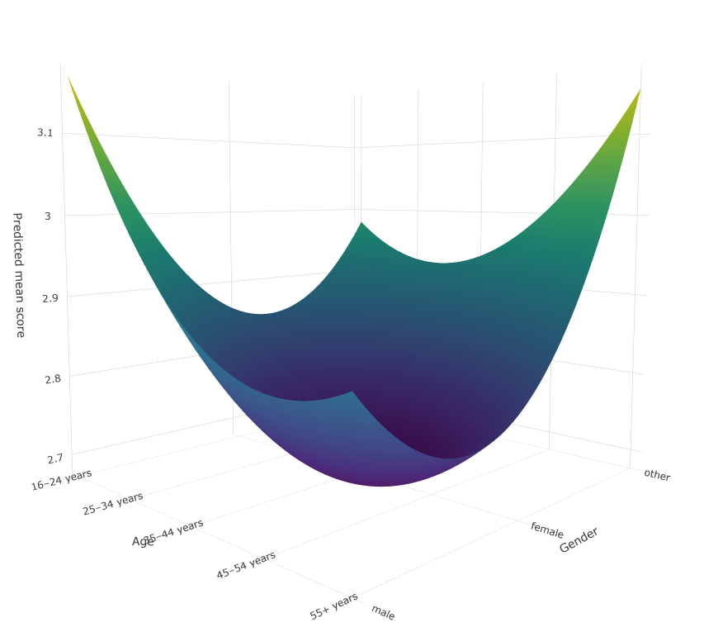
Replication of Figures 1–4
Q41 2021 Plot
Figures generated using polynomial regression
Visualization replicated patterns:
  Increasing comfort with higher income & education
  Lower comfort among older age groups
Notes:
The figures we replicated also showed similar directional patterns.
Comfort with AI and acceptance of data usage generally increases with income and education, while older age groups show more skepticism.
These figures visually reinforce the statistical trends found in the regression models.

Slide 8
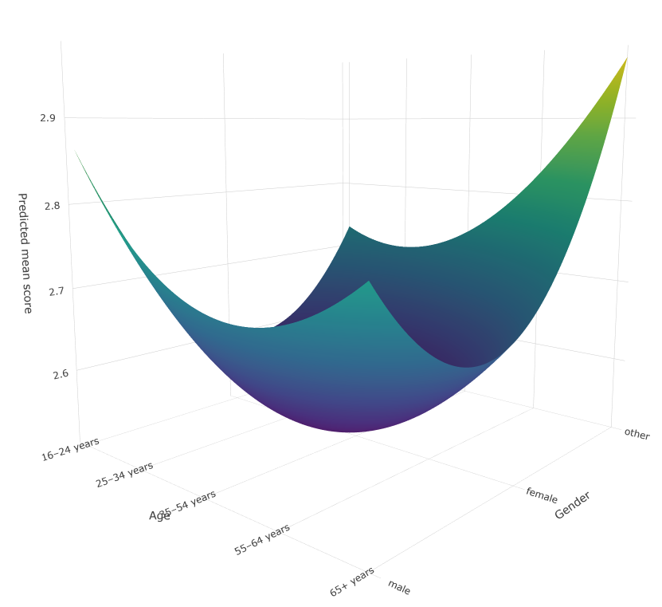
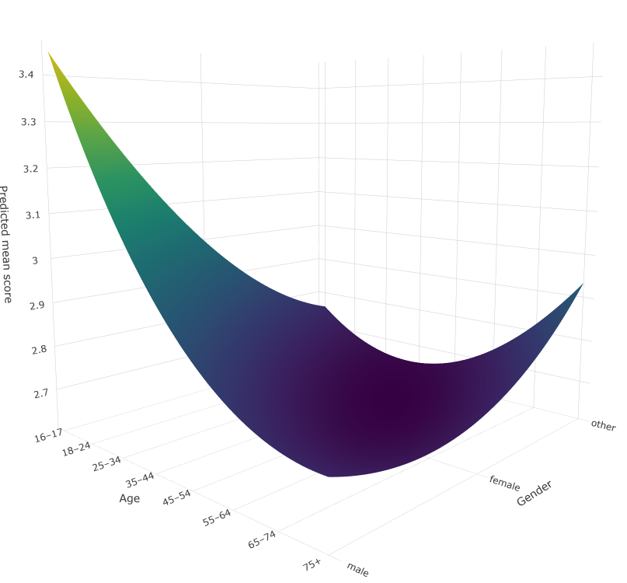
Extension: New Datasets (2023 & 2024)
We generate 3D predictive surfaces to observe interactions
Goal: visualize how comfort varies jointly across demographics
Model: (to be filled after code running)
Outputs: 3D surfaces comparing 2021 → 2023 → 2024
3D Surface Plot for 2023 Q32 [3].
3D Surface Plot for 2024 Q29_A3 [4].
Notes:
To go beyond replication, we extended the study by incorporating 2023 and 2024 survey data.
Using multivariate modeling, we built 3D predictive surfaces that show how comfort varies simultaneously with demographic factors.
This offers a richer visualization that the original paper did not explore.

Slide 9
Reflection: What We Learned
Data cleaning can change results
Filtering choices impact sample size & interpretation
Reproducibility requires matching reference categories
Minor discrepancies are expected when preprocessing is unclear
Reproducibility Challenges
Lack of clarity on original preprocessing
Slight differences in age bins
Assumption violations in ordinal models (minor)
Still replicated overall trends successfully
Notes:
One of our biggest takeaways was how much decisions during data cleaning affect results.
Slight differences in filtering can change sample size and even influence interpretation.
It shows how important transparency and documentation are in real research.
We encountered a few reproducibility challenges, mainly because the original preprocessing steps were not fully described.
Another issue was the mismatch in age categories.
Despite these challenges, the main trends were successfully reproduced, which strengthens the credibility of the original study.

Slide 10
Teamwork Summary
Entire group: brainstorming & dataset access
Coding & modeling: Kai, Aymen and Gary
Report writing & presentation: Agam, Leila, Zayn
Emphasized communication, collaboration & division of roles
AI Use Disclosure
AI used for:
  Formatting & editing text
  Code organization
  Clarification
All statistical analysis performed by the team
Notes:
This project included both individual strengths and collaboration.
Some team members focused more on coding and analysis, while others contributed more toward presentation, documentation, and interpretation.
Overall, coordination and communication were keys to completing this project successfully.
We followed project guidelines by documenting how AI tools were used only to assist with editing, organization, and coding support.
Importantly, all statistical modeling and data analysis were performed by our team.
This ensures that our findings are trustworthy and reflect actual student work.

Slide 11
THANKS!
Q & A
Notes:
Subgroup analysis: Run regressions by gender, age group, or healthcare professionals vs. general population.
Interaction effects: Add interaction terms (e.g., Age × Gender, Knowledge × Demographics) to explore moderation.
Longitudinal comparison: Extend analysis using CDHS 2023 (Environics Research + CIFAR, n ≈ 10,130). Compare 2021 vs. 2023 to assess changes in AI knowledge and comfort.
Additional variables: Incorporate other survey items (e.g., digital health usage, regional variation) to enrich the model.

